Slide 1
Analog Communication Presentation on: Beam Scanning, Horizontal Scanning and Vertical Scanning
Presented to:
Md. Imran Hossain
Assistant Professor
Dept. of iCT
Presented by:
MD. Najmul Islam Nayeem
ID: 11809005
Dept. of ICT

Slide 2
Beam Scanning:
What is Beam scanning?
The process which is performed in picture tube to convert optical information to electrical signal.
The fine and sharp electric beam is used to scan the focused image and beam convert optical information to electric signal element by element and line after line till the entire picture/image is scanned.

Slide 3
How Beam scanning works?
The electron beam generated by the picture tube is accelerated toward the anode by a combination of elements and extreme high voltage (difference of potential) until it strikes the phosphorous coated anode.
The high energy impact emits light or a dot in the center of the picture tube which is visible to our eyes.
Then the beam is deflected using the deflecting coil to move it horizontally or vertically line by line to create an entire image.

Slide 4
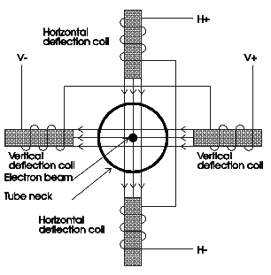
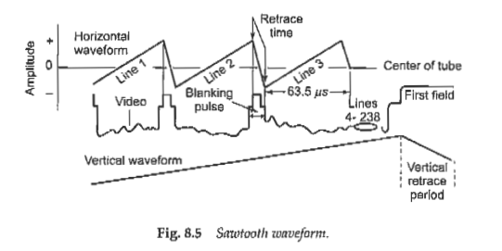
Deflection Coil and Sawtooth Waveform

Slide 5
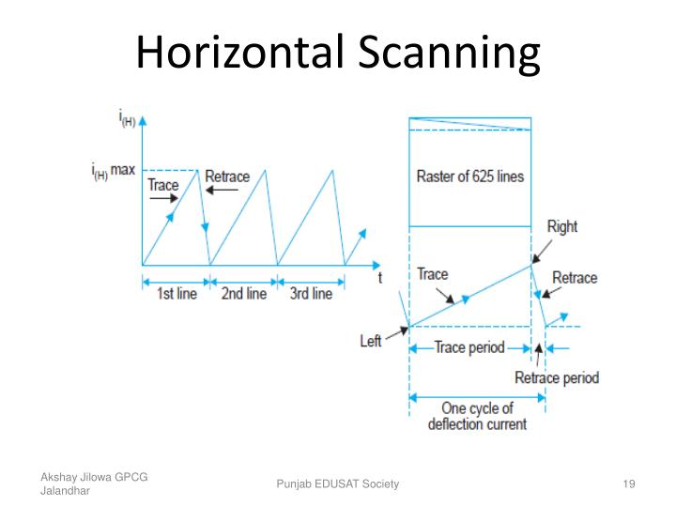
Types of beam Scanning:

Slide 6
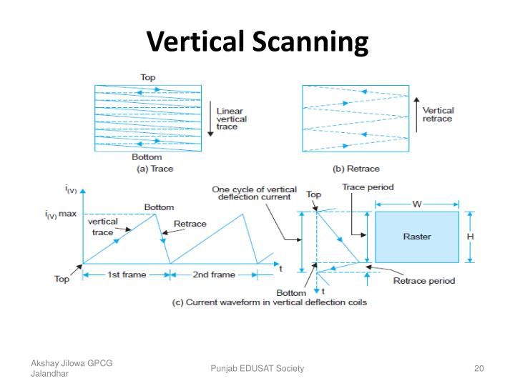
Types of beam Scanning:

Slide 7
Horizontal Scanning
The scanning in which electron beam is deflected from left to right to scan a line of the image is called horizontal scanning.
1) The sawtooth wave applied to the horizontal portion of the deflection coil which creates a magnetic field and deflects the beam to the extreme left side of the picture tube at the start of each cycle.
2)The beam moves evenly across the tube face as the wave increases in amplitude until maximum amplitude is reached and the voltage drops immediately to its original starting point (retrace period).
3)Up to this point we have traced (illuminated) one line from left to right across the picture tube face.
Now the process starts over again on the next cycle.

Slide 8
Vertical Scanning
The scanning in which electron beam is deflected from top to bottom to scan a line of the image is called vertical scanning.
1) The sawtooth wave is applied to the vertical portion of the deflection coils that creates a magnetic field and deflects the beam to the top side of the picture tube at the start of each cycle.
2) The beam moves evenly across the tube face as the wave increases in amplitude until maximum amplitude is reached and the voltage drops immediately to its original starting point (retrace period).
3) Up to this point one line from top to bottom across the picture tube face is scanned.
Now the process starts over again on the next cycle.

